Slide 1
inspiring school leader
experienced work pressure
EXAMPLE
quality education
sick leave
team involvement
number of innovations

Slide 2
Variable
Variable
Variable
Variable
Variable
Variable

Slide 3
Variable
Double click on Variable and type the desired variable.
Note: a variable can be large or small; many or less; more or less
Tip: Unused variables can be deleted

Slide 4
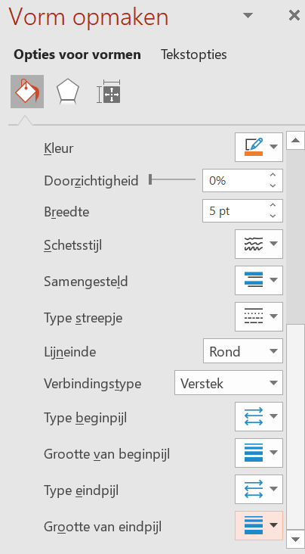
Relation arrows
Choose: Insert, Shapes, Curve
Click at the beginning, in the middle and at the end. Close with Enter
Note: a click in the middle makes the bend in the arrow
Tip: right click on the arrow and choose Format Shape

Slide 5
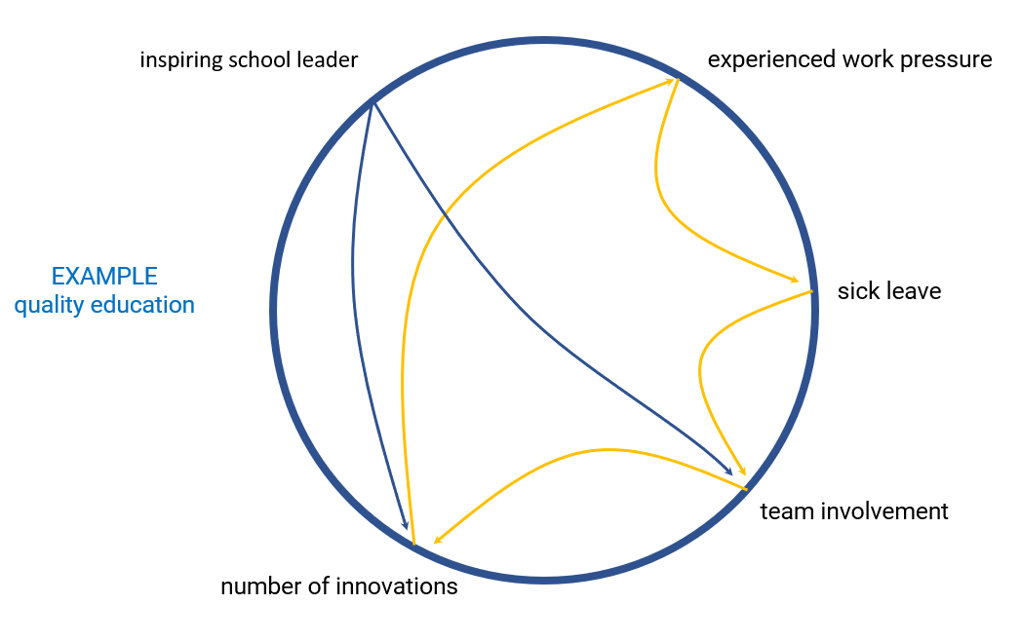
Loops
Try to find loops and give them the same color

